Slide 1



Infosys Springboard Virtual Internship 6.0
Food Trends Understanding Using Customer Preferences
GROUP 1 BATCH 11
NAME:HARINI M
MENTOR NAME :NITHYA SREE
Notes:
1

Slide 2

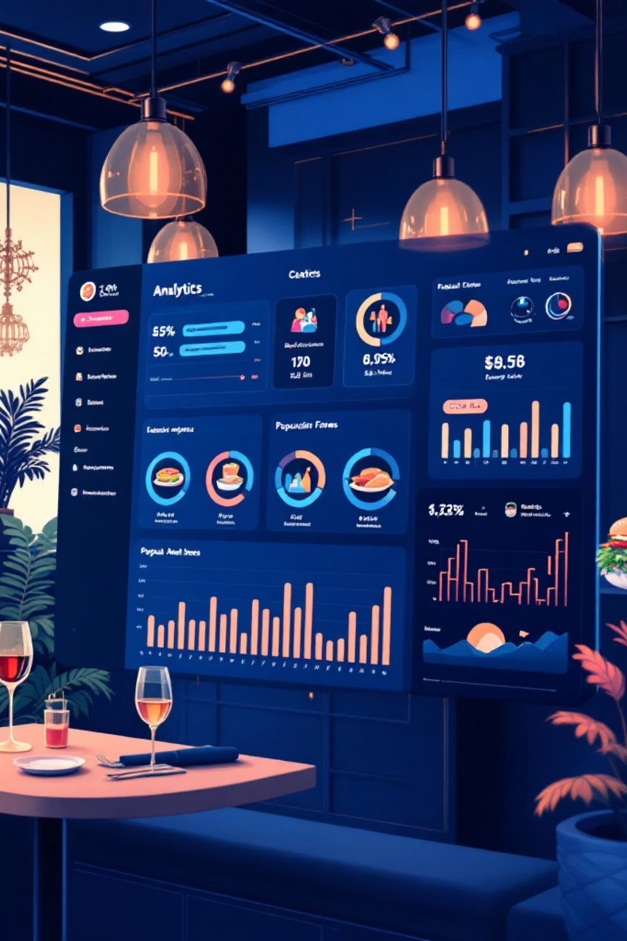
PROJECT OBJECTIVE
Transforming Restaurant Data Into Strategic Insights
The objective of this project is to analyze a global restaurant dataset to understand customer engagement patterns, rating reliability, cuisine demand, pricing behavior, and service availability. Restaurants receive ratings and votes from customers, but these metrics alone do not always represent true performance. This project focuses on evaluating restaurant performance by combining customer participation, operational features, and rating stability. Using Power BI dashboards, the project transforms raw restaurant data into meaningful insights that support accurate performance evaluation and data-driven decision-making
Notes:
2

Slide 3
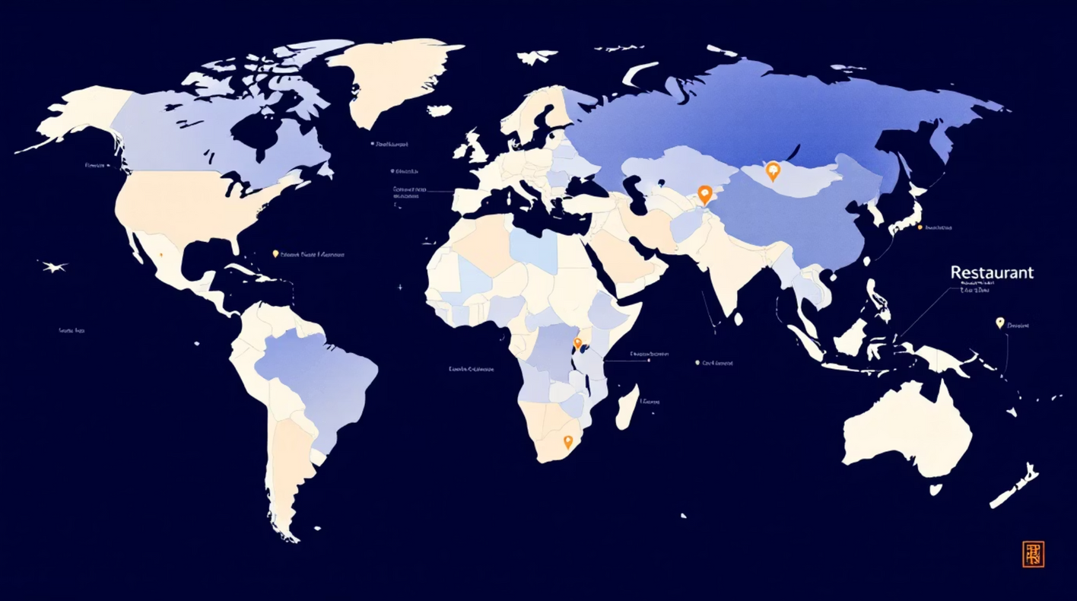
Project Description:
• Project focuses on analyzing restaurant performance using a worldwide dataset from Kaggle • Dataset contains attributes such as restaurant location, cuisine type, ratings, votes, and pricing • Global dataset enables analysis of diverse restaurant environments and customer behavior patterns • Power BI was used to clean, transform, and visualize the dataset • Interactive dashboards were developed to identify engagement trends and performance insights • Project helps convert raw data into structured analytical insights for decision support
Notes:
3

Slide 4
Top Visualizations Used
The project primarily uses four impactful visualizations to communicate insights effectively:
• Scatter Chart — Used to analyze the relationship between customer votes and ratings, helping evaluate rating reliability.
• Column Chart — Enables clear comparison of restaurant performance across cuisines, cities, and operational categories.
• Line Chart — Highlights trends such as rating stability and engagement progression over vote ranges.
These visualizations were selected to represent relationships, comparisons, trends, and distributions in a clear and meaningful way.
Notes:
4

Slide 5





EXECUTION MILESTONE
Four-Phase Development Approach
The project was executed through structured in to 4 milestones to ensure systematic development from raw data preparation to strategic insights.
MILESTONE 1:Data Collection & Preprocessing
MILESTONE 2:Core Dashboard Development
Collected and cleaned restaurant dataset using Power Query. Handled missing values, standardized formats, and created derived columns for analysis.
Built initial dashboards analyzing customer engagement, ratings, cuisine popularity, pricing trends, and location-based patterns.
MILESTONE 3:Advanced Analytics
MILESTONE 4:Strategic Insights
Created sophisticated dashboards evaluating rating consistency and customer participation. Explored analytical relationships between votes and ratings.
Categorized restaurants into action-based groups: promotion, improvement, or monitoring. Converted findings into decision frameworks.
Notes:
5

Slide 6

Challenges
Data Quality Issues
Power BI Complexity
Visualization Design
Handled incomplete and inconsistent data through careful cleaning and validation processes to ensure accurate analytical results.
Managed filter interactions and calculated measures, particularly when analyzing rating reliability and customer engagement patterns.
Selected appropriate visualizations to clearly represent complex relationships between votes, ratings, and performance metrics.
Resolution
Implemented data cleaning and preprocessing techniques to improve data accuracy and consistency. Optimized Power BI data modeling using proper relationships, filters, and efficient DAX measures to reduce complexity. Selected appropriate visualizations such as charts and KPIs to clearly represent performance metrics. Improved dashboard design with interactive features like slicers for better user experience. These steps ensured reliable analysis and more meaningful insights.
Notes:
7

Slide 7

Skills Developed & Practical Outcomes
Skills Developed
• Developed strong proficiency in Power BI dashboard creation and report design • Learned data preprocessing using Power Query, including cleaning, transforming, and structuring raw data • Improved ability to create and use DAX measures and calculated columns for analytical insights • Gained experience in selecting appropriate visualizations based on analytical requirements • Strengthened data interpretation skills by analyzing ratings, customer engagement, and performance patterns • Improved understanding of data modeling concepts such as relationships, filters, and aggregation • Developed skills in converting raw data into meaningful business insights • Enhanced ability to work with real-world datasets and handle data inconsistencies
Practical Outcomes
• Successfully built interactive Power BI dashboards for restaurant performance analysis • Transformed a raw dataset into a structured analytical framework • Identified customer engagement patterns and rating reliability trends • Categorized restaurants based on performance for strategic prioritization • Created a system that supports data-driven decision-making • Gained hands-on experience in end-to-end data analytics workflow • Developed practical exposure to business intelligence tools used in industry • Improved confidence in handling real-world analytics projects independently
Notes:
8

Slide 8




Key Findings & Strategic Implications
Engagement Drives Reliability
Cuisine & Pricing Impact
Service Features Matter
Regional Variations
Significant performance differences across locations highlight the importance of regional analysis and localized strategies.
Restaurants with higher vote participation demonstrate more stable and trustworthy ratings, indicating quality consistency.
Customer interaction is significantly influenced by cuisine preferences and pricing strategies across different markets.
Online delivery and accessibility features improve customer engagement and expand market reach effectively.
Notes:
9

Slide 9


FUTURE ENHANCEMENT
Potential Enhancements & Next Steps
Real-Time Data Integration
Incorporate live data feeds to enable dynamic monitoring of restaurant performance and immediate trend detection.
Predictive Analytics
Forecast demand and trends
Predictive Analytics
Advanced Recommendations
Implement machine learning models to forecast customer behavior, rating trends, and demand patterns.
Real-time Integration
Ingest live data feeds
Deliver personalized actions
Strategic enhancements will transform this analytical foundation into a dynamic, predictive system.
Advanced Recommendations
Develop intelligent recommendation engines to improve decision-making and performance evaluation accuracy.
Notes:
10

Slide 10
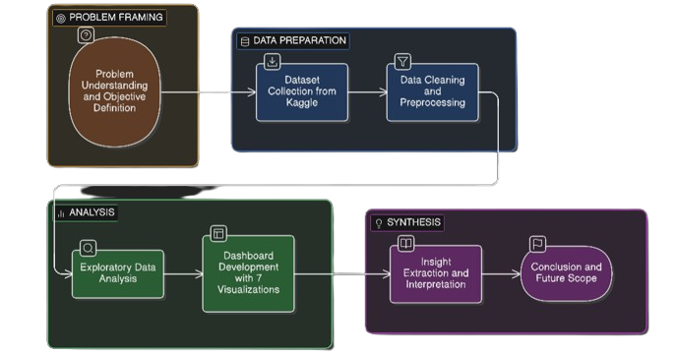
WORK FLOW
Notes:
10

Slide 11

Conclusion:
This project demonstrates how structured restaurant data can be transformed into meaningful insights through effective preprocessing and visualization. By analyzing customer engagement, ratings, cuisine trends, pricing, and service availability, the dashboards provide a comprehensive view of restaurant performance across global markets.
The integration of analytical logic with visualization supports data-driven decision-making and strategic prioritization. This work highlights the practical value of business intelligence in understanding real-world performance patterns and improving evaluation processes in the competitive restaurant industry.
Key Takeaway: Combining technical execution with strategic thinking creates actionable insights that drive meaningful business outcomes.
Notes:
11

Slide 12
Acknowledgement:
I would like to express our heartfelt gratitude to: Infosys Springboard Team– for organizing this valuable internship opportunity. Our Mentor– for her continuous support and feedback.
My Teammates – for collaboration, encouragement, and insights This internship has been a significant step in our professional growth and technical journey.
References:
Microsoft Power BI Documentation
Infosys Springboard Virtual Internship course materials
Data Set :zomato_restaurants.csv
Source :Kaggle
Notes:
12

Slide 13
THANK YOU
Notes:
13

